Slide 1
Intro to Machine Learning
By DK Kim, UKC DSHW 2019 Chicago

Slide 2
Outline
Background
What is Machine Learning?
Machine Learning VS Statistics
Learning Algorithms & Applications
Supervised Learning
Unsupervised Learning
Reinforcement Learning
Deep Learning
Model Evaluation
Bias-Variance Tradeoff
Naive Bayes
Logistic Regression

Slide 3
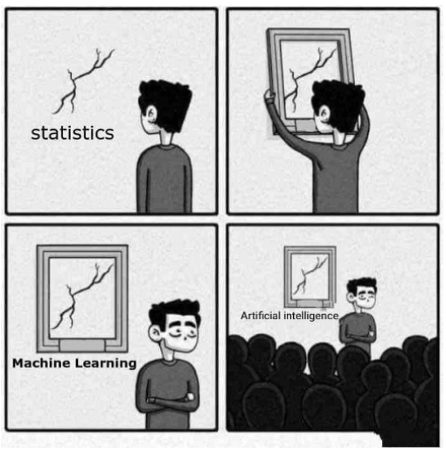
Background - What is Machine Learning?
Machine learning is the science of getting computers to act without being explicitly programmed.

Slide 4
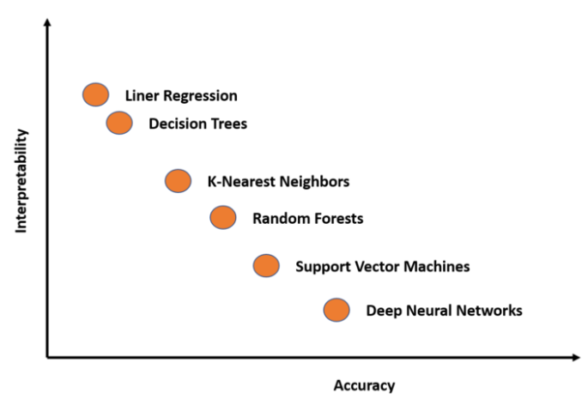
Interpretability vs Accuracy

Slide 5
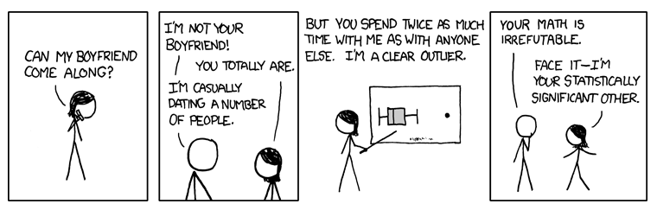
Machine Learning VS Statistics
“Statistics draws population inferences from a sample, and machine learning finds generalizable predictive patterns.” - Nature Methods
Notes:
Machine learning is all about results, it is likely working in a company where your worth is characterized solely by your performance. Whereas, statistical modeling is more about finding relationships between variables and the significance of those relationships, whilst also catering for prediction.

Slide 6
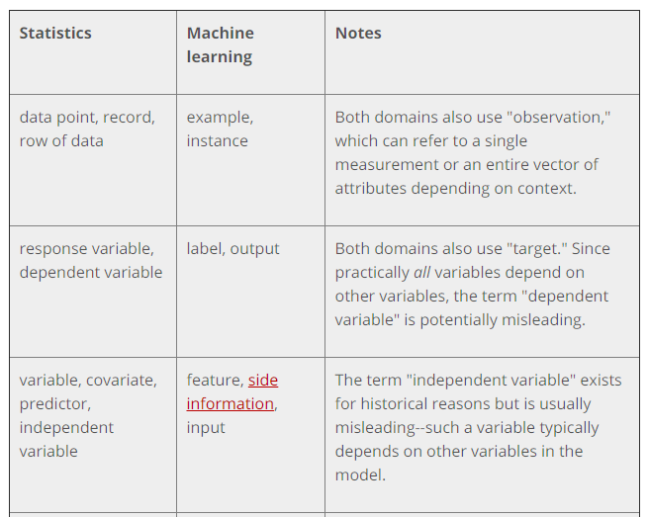
Machine Learning VS Statistics
Notes:
Translating Between Statistics and ML - https://insights.sei.cmu.edu/sei_blog/2018/11/translating-between-statistics-and-machine-learning.html

Slide 7
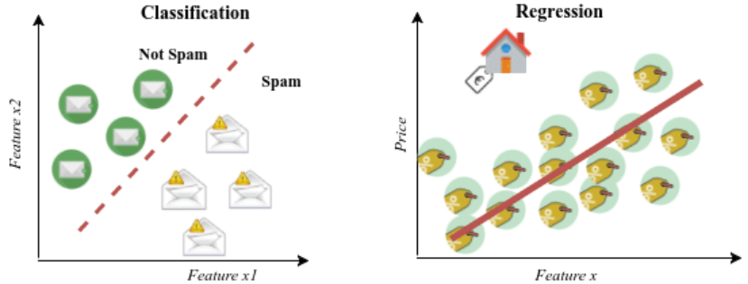
Learning Algorithms - Supervised Learning
Supervised learning is done using a ground truth, or in other words, we have prior knowledge of what the output values for our samples should be.

Slide 8
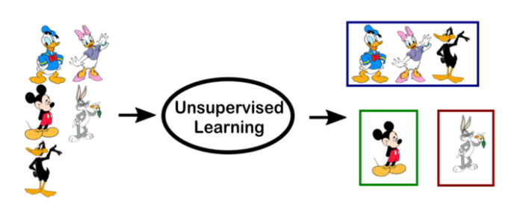
Learning Algorithms- Unsupervised Learning
Unsupervised learning, on the other hand, does not have labeled outputs, so its goal is to infer the natural structure present within a set of data points.

Slide 9
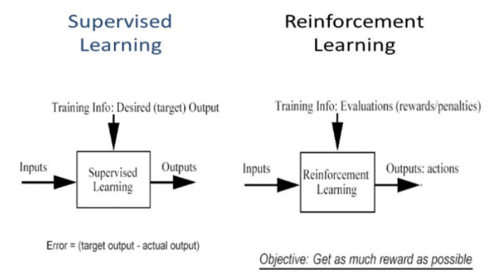
Learning Algorithms- Reinforcement Learning
Notes:
RL is not exactly supervised, because it does not rely strictly on set of “supervised” (or labeled) data (the training set). It actually relies on being able to monitor the response of the actions taken, and measure against a definition of a “reward”. But it’s not unsupervised learning either, since we know upfront when we model our “learner” which is the expected reward.

Slide 10
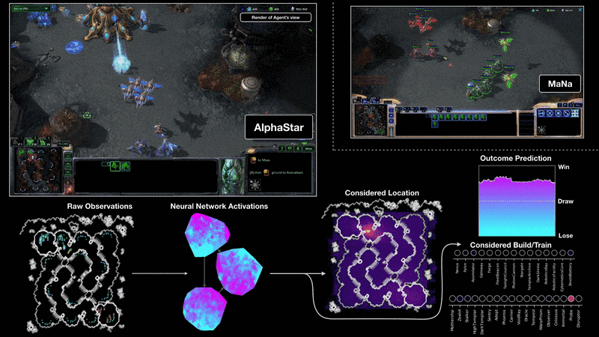
Learning Algorithms - Reinforcement Learning
Reinforcement learning is an autonomous, self-teaching system that essentially learns by trial and error. It performs actions with the aim of maximizing rewards.
Notes:
A VISUALISATION OF THE ALPHASTAR AGENT DURING GAME TWO OF THE MATCH AGAINST MANA. THIS SHOWS THE GAME FROM THE AGENT’S POINT OF VIEW: THE RAW OBSERVATION INPUT TO THE NEURAL NETWORK, THE NEURAL NETWORK’S INTERNAL ACTIVATIONS, SOME OF THE CONSIDERED ACTIONS THE AGENT CAN TAKE SUCH AS WHERE TO CLICK AND WHAT TO BUILD, AND THE PREDICTED OUTCOME. MANA’S VIEW OF THE GAME IS ALSO SHOWN, ALTHOUGH THIS IS NOT ACCESSIBLE TO THE AGENT.

Slide 11
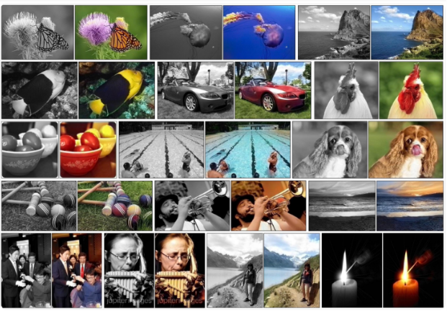
Learning Algorithms - Deep Learning
Deep learning is essentially an autonomous, self-teaching system in which you use existing data to train algorithms to find patterns and then use that to make predictions about new data.

Slide 12
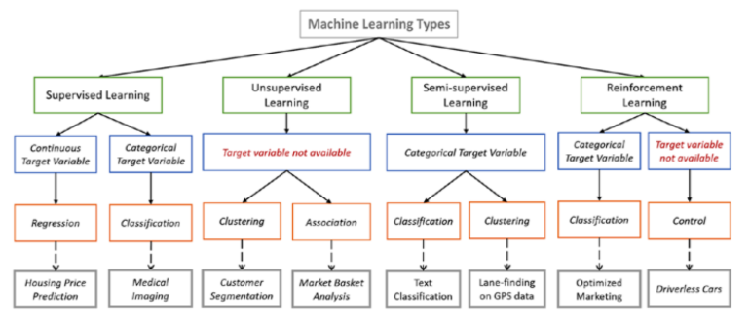
Overview of Learning Algorithms

Slide 13
Reference
Dr. Edward Choi, Dr. Hwiyoung Kim
https://towardsdatascience.com/the-actual-difference-between-statistics-and-machine-learning-64b49f07ea3
https://www.analyticsvidhya.com/blog/2015/12/hilarious-jokes-videos-statistics-data-science/
https://insights.sei.cmu.edu/sei_blog/2018/11/translating-between-statistics-and-machine-learning.html
https://github.com/ctufts/Cheat_Sheets/wiki/Classification-Model-Pros-and-Cons

Slide 14
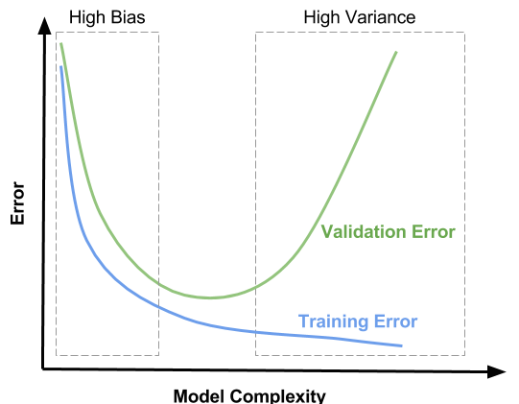
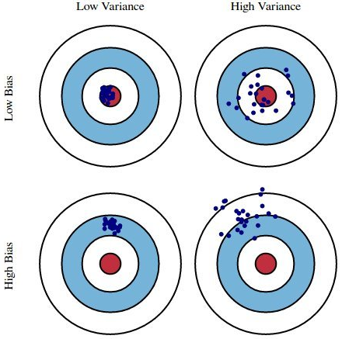
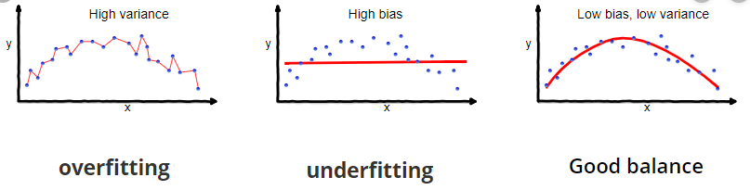
Bias-Variance Tradeoff

Slide 15
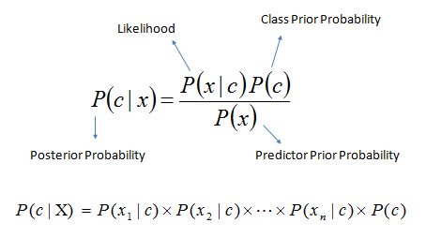
Naive Bayes
Pros:
Computationally Fast
Simple to implement
Works well with high dimensions
Cons:
Relies on independence assumption and will perform badly if it’s not met

Slide 16
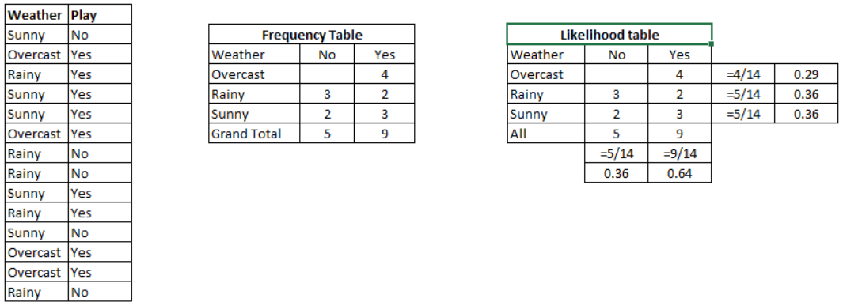
Naive Bayes

Slide 17
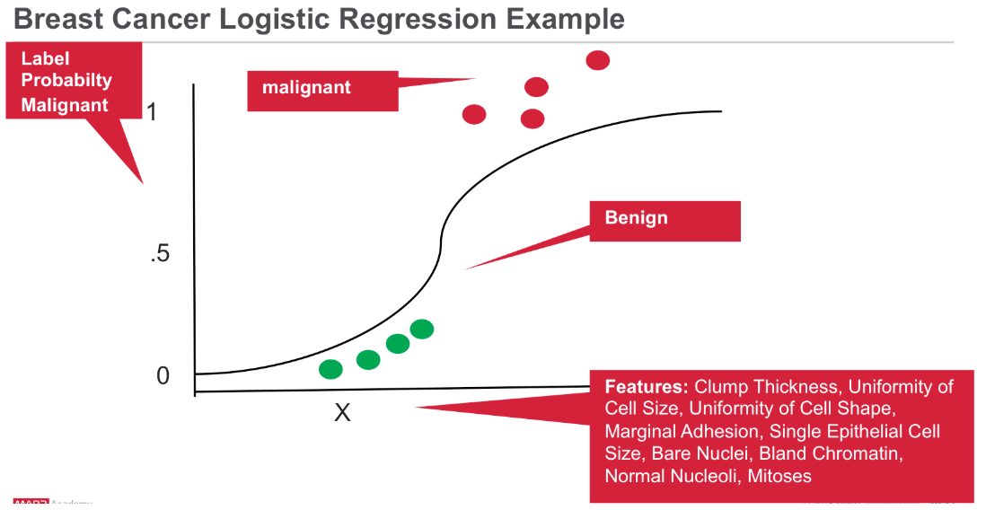
Logistic Regression
Pros:
Easy to understand
Low Variance
Cons:
Performs poorly with correlated features
High Bias

Slide 18
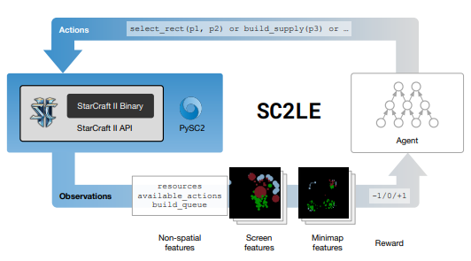
Learning Algorithms - Deep Learning vs Reinforcement Learning
Deep learning and reinforcement learning are both systems that learn autonomously. The difference between them is that deep learning is learning from a training set and then applying that learning to a new data set, while reinforcement learning is dynamically learning by adjusting actions based in continuous feedback to maximize a reward.

